Slide 1
Introduction of DBMS

Slide 2
Definition of file:
A file in a Database Management System (DBMS) is a collection of related records stored on a secondary storage device (like a hard disk), which is used by the DBMS to store and manage data permanently.
Basic File Operations:
Open: Opens a file in either read or write mode.
Create: Creates a new database file.
Delete: Deletes an existing database file.
Read: Retrieves data from a file.
Write: Inserts or updates data in a file.
Update: Modifies existing data within a file.

Slide 3
Types of file (Logical & Physical)
Logical File:
Data is organized for users or applications, independent of how it's stored physically on disk.
Examples of Logical Files:
Text Files: Contain readable characters (letters, numbers)
Example: .txt, .csv, .log
Binary Files: Contain data in binary form (not human-readable)
Example: .exe, .jpg, .dat
Database Files: Store structured data used by DBMS
Example: .db, .mdb, .sqlite
Multimedia Files: Store audio, video, or images
Example: .mp3, .mp4, .png

Slide 4
Types of file (Logical & Physical)
Physical File:
How data is actually stored on physical storage (hard disk, SSD, etc.) and how it's accessed by the system.
Example of Physical Files:
Sequential File: Data is stored and accessed in a linear order (one by one)
Direct/Random Access File: Data can be accessed directly using an address or index
Indexed File: Uses an index to speed up access to records
Hashed File: Uses a hash function to calculate the location of records

Slide 5
Definition of DBMS (Database Management System)
A Database Management System (DBMS) is software that allows users to create, store, manage, retrieve, and manipulate data in a structured and organized way using databases.
Examples of DBMS:
Relational:
MySQL, PostgreSQL, Oracle, SQL Server
NoSQL:
MongoDB, Cassandra, Firebase
Embedded:
SQLite (used in mobile apps)
Cloud-Based:
Amazon RDS, Google Cloud Firestore

Slide 6
File System Vs. DBMS
File System | DBMS
Stores data in files (like text, CSV, Excel files). | Manages data in structured databases with software.
Data stored in flat files without relationships. | Data stored in tables with defined relationships.
Manual search or basic tools to find data. | Powerful query languages like SQL for quick retrieval.
High – same data might be repeated in many files. | Low – uses normalization to minimize duplication.
Manual backup required. | Automated backup and recovery tools.

Slide 7
Applications of DBMS
Railway Reservation System: It is used to keep record of booking of tickets, departure of the train and the status of arrival and give updates to the passengers with the help of a database.
Library Management System: There will be so many numbers of books in the library and it is very hard to keep a record of all the books in a register or a copy. So, DBMS is necessary to keep track of all the book records, issue dates, name of the books, author and maintain the records.
Banking: We are doing a lot of transactions daily without directly going to the banks. The only reason is the usage of databases and it manages all the data of the customers over the database.
Educational Institutions: All the examinations and the data related to the students maintained over the internet with the help of a database management system. It contains registration details of the student, results, grades and courses available. All these works can be done online without visiting an institution.
Social Media Websites: By filling the required details we are able to access social media platforms. Many users daily sign up for social websites such as Facebook, Pinterest and Instagram. All the information related to the users are stored and maintained with the help of DBMS.

Slide 8
Purpose of Database Systems:
Data Efficiency: Handle vast amounts of data without losing performance.
Data Integrity and Accuracy Maintain consistent and accurate data using rules and constraints.
Fast and Flexible Data Retrieval Enable quick searches, sorting, and filtering through queries.
Multiple Users and Concurrent Access Let many users access and update data safely at the same time.
Data Security and Privacy Control who can view or modify data through authentication and permissions.
Backup and Recovery Protect data from loss by providing mechanisms to back up and restore it.
Enforce Data Relationships Manage connections between different data entities (e.g., customers and orders).

Slide 9
Advantages of DBMS
Reduced Redundancy:
Eliminates duplicate data using relational design.
Data Consistency:
Updates appear everywhere data is used.
Better Data Security:
Controls access using user roles and permissions.
Data Sharing:
Multiple users can access data at the same time.
Backup & Recovery:
Automatically recovers data after crashes.
Easy Querying:
SQL makes data retrieval simple and fast.
Relationship Management:
Handles linked data via foreign keys.

Slide 10
Disadvantages of DBMS
High Cost
Licensing and maintenance can be expensive.
Complexity
Requires trained personnel to set up and manage.
Large Storage Needs
DBMS software and logs take significant disk space.
Higher impact of a failure

Slide 11
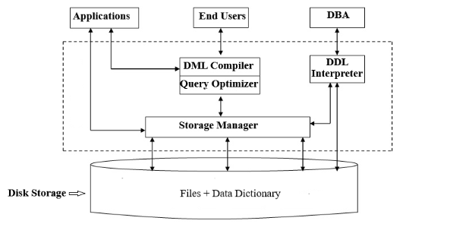
Structure of DBMS

Slide 12
DBMS users
Database Administrator (DBA)
Database Designer
Application Programmer / Developer
End Users
Naive (Casual) Users
Sophisticated Users
Specialized Users
Stand-alone Users

